Slide 1
Nuclear Fuel Performance
NE-533
Spring 2024

Slide 2
Last Time

Slide 3
grain Properties/Behavior

Slide 4
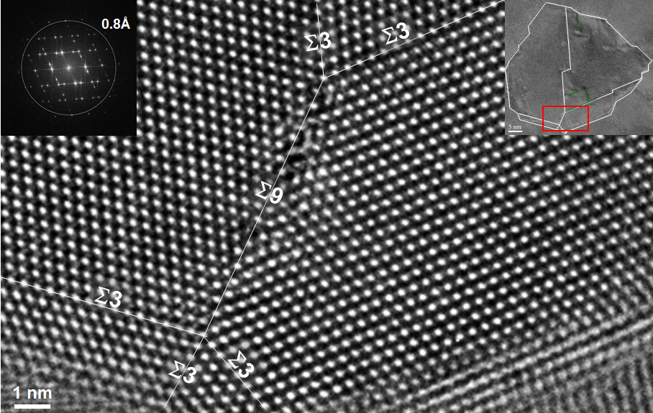
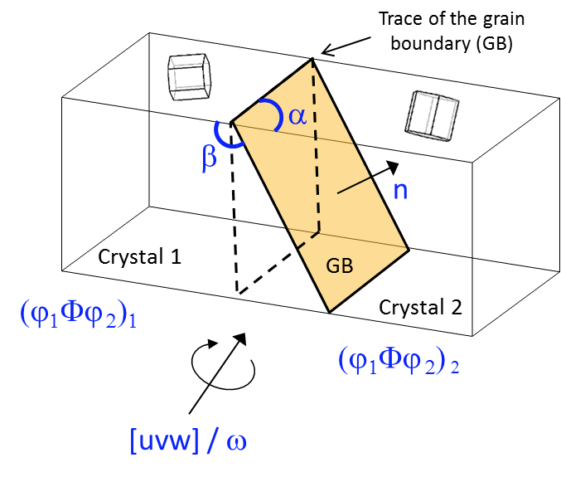
Grain Boundaries
Materials are typically composed of various regions where the crystal lattice is oriented differently
When two grains meet, there is a plane of atoms that do not follow the crystal lattice called a grain boundary
Grain boundaries add energy to the material that is a function of their structure
A grain boundary’s energy is determined by its:
Inclination – the orientation of the 2D grain boundary plane (2 degrees of freedom)
misorientation – the rotation required to align one grain with the other (3 degrees of freedom)

Slide 5
Grain Texture
The orientation of all the grains in a material is called the texture
The degree of texture is dependent on the percentage of crystals having a preferred orientation
randomly oriented grains equals no texture
Texture is seen in almost all engineered materials, and can have a great influence on materials properties

Slide 6
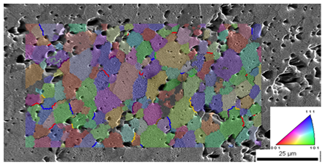
Grain size
In a polycrystal, there is also a distribution of grain sizes
The average grain size of the fuel has a significant impact on its behavior
Typical LWR fuel has an initial average grain size of about 10 microns
The average grain size impacts
Fission gas release
Swelling
Thermal conductivity
Creep

Slide 7
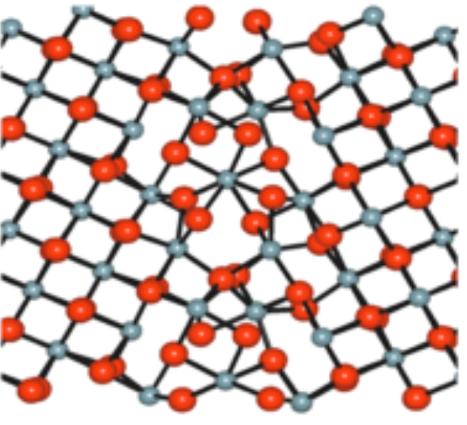
Grain boundary diffusion
Diffusion often occurs faster along grain boundaries than in the perfect crystal
Grain boundaries have more space than the perfect lattice
So, atoms diffuse faster along grain boundaries than through the perfect lattice
This means that grain boundary, or intergranular, diffusion increasingly dominates bulk (intragranular) diffusion
This can become more pronounced as the temperature is reduced
Grain boundary diffusion has a large impact on creep

Slide 8
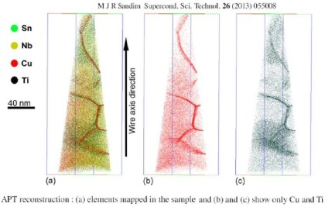
Grain boundary segregation
Impurity atoms (such as fission gas) and other defects move to grain boundaries
Due to grain boundaries having more open space, impurity atoms have a lower energy when they are on grain boundaries.
This is called grain boundary segregation
Radiation induced segregation (RIS) is where radiation produces defects that drive towards the grain boundary and preferentially drag solute atoms

Slide 9
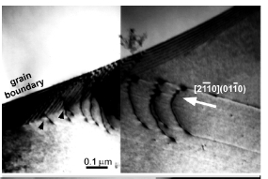
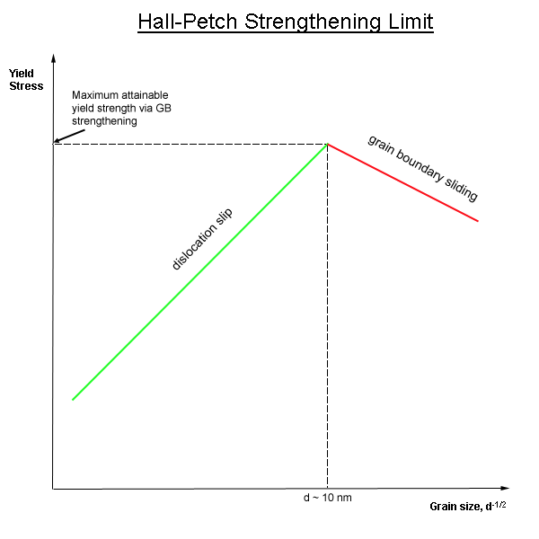
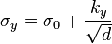
Dislocation interaction with grain boundaries
Grain boundaries impede dislocation motion
The number of dislocations within a grain impacts how easily dislocations can traverse grain boundaries and travel from grain to grain
So, by changing grain size one changes barrier density, influencing dislocation movement and yield strength
This is called the Hall-Petch effect
where σ_{y} is the yield stress, σ₀ is a materials constant for the starting stress for dislocation movement (or the resistance of the lattice to dislocation motion), k_{y} is the strengthening coefficient (a constant specific to each material), and d is the average grain diameter

Slide 10
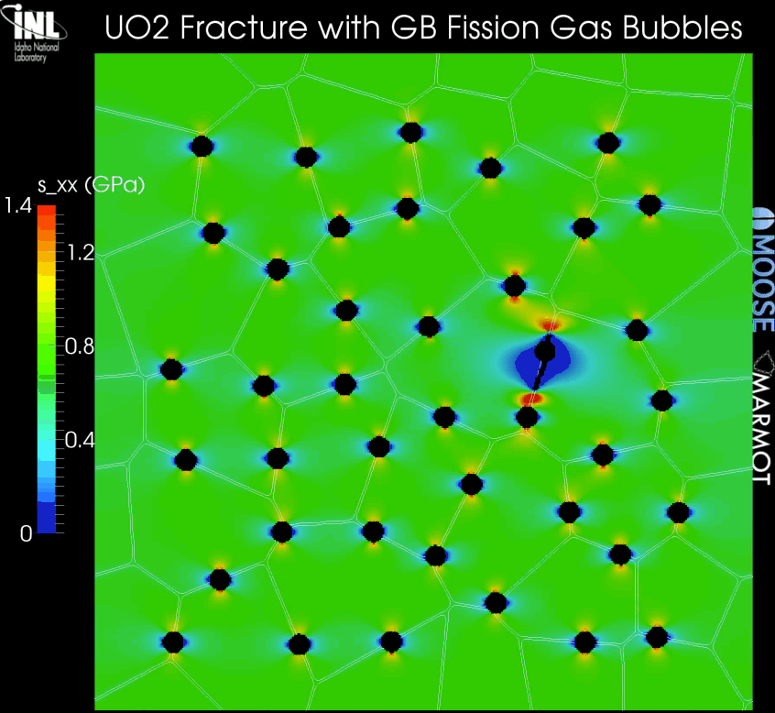
Grain boundaries and cracks
Materials often crack along grain boundaries
Grain boundaries can be weaker than the perfect lattice
different bonding environment, increased extrinsic particles, etc.
Thus, fracture will often occur along grain boundaries (intergranular fracture)

Slide 11
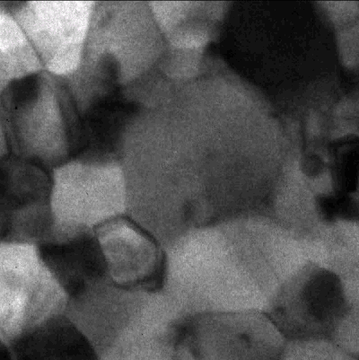
Grain size change
A single crystal has a lower energy state than a polycrystal, due to the grain boundary energy
So, grain boundaries migrate to reduce the energy
v_{GB} = M_{GB} (P_{d} – P_{r})
M_{GB} is the grain boundary mobility
P_{d} is the driving force (pressure) for grain growth
P_{r} is the pressure resisting grain growth

Slide 12
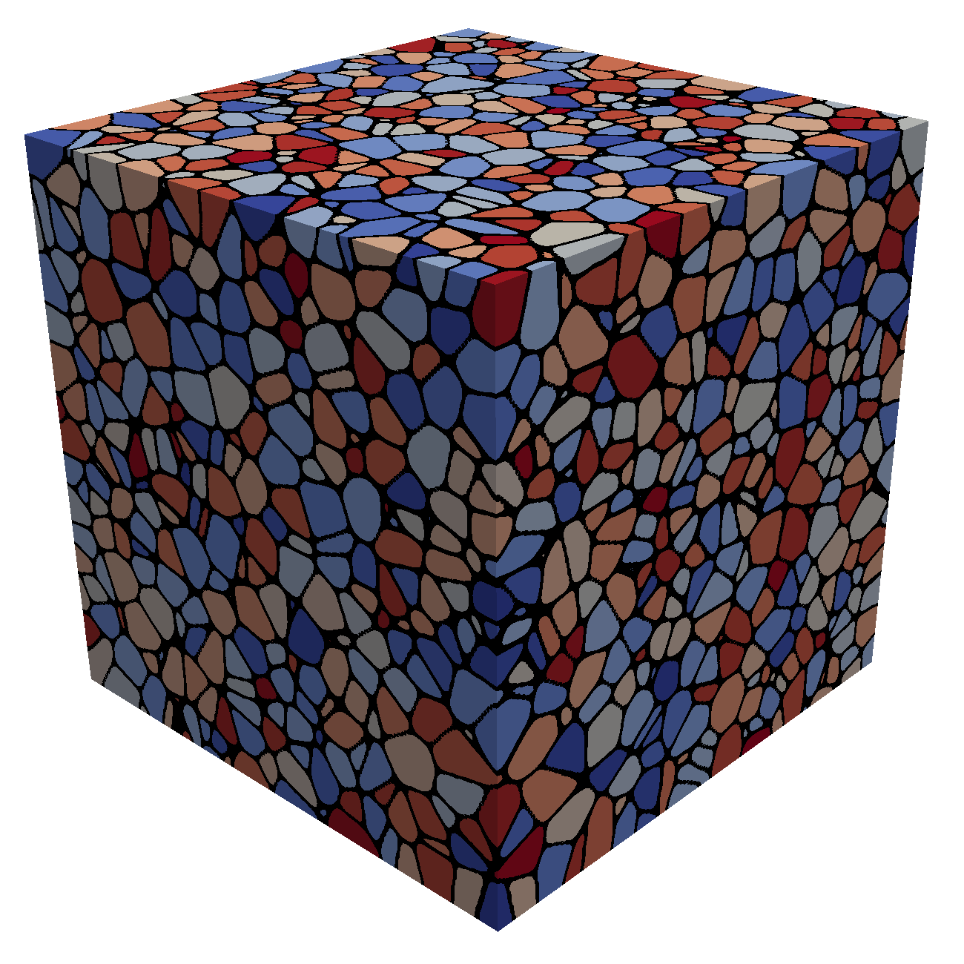
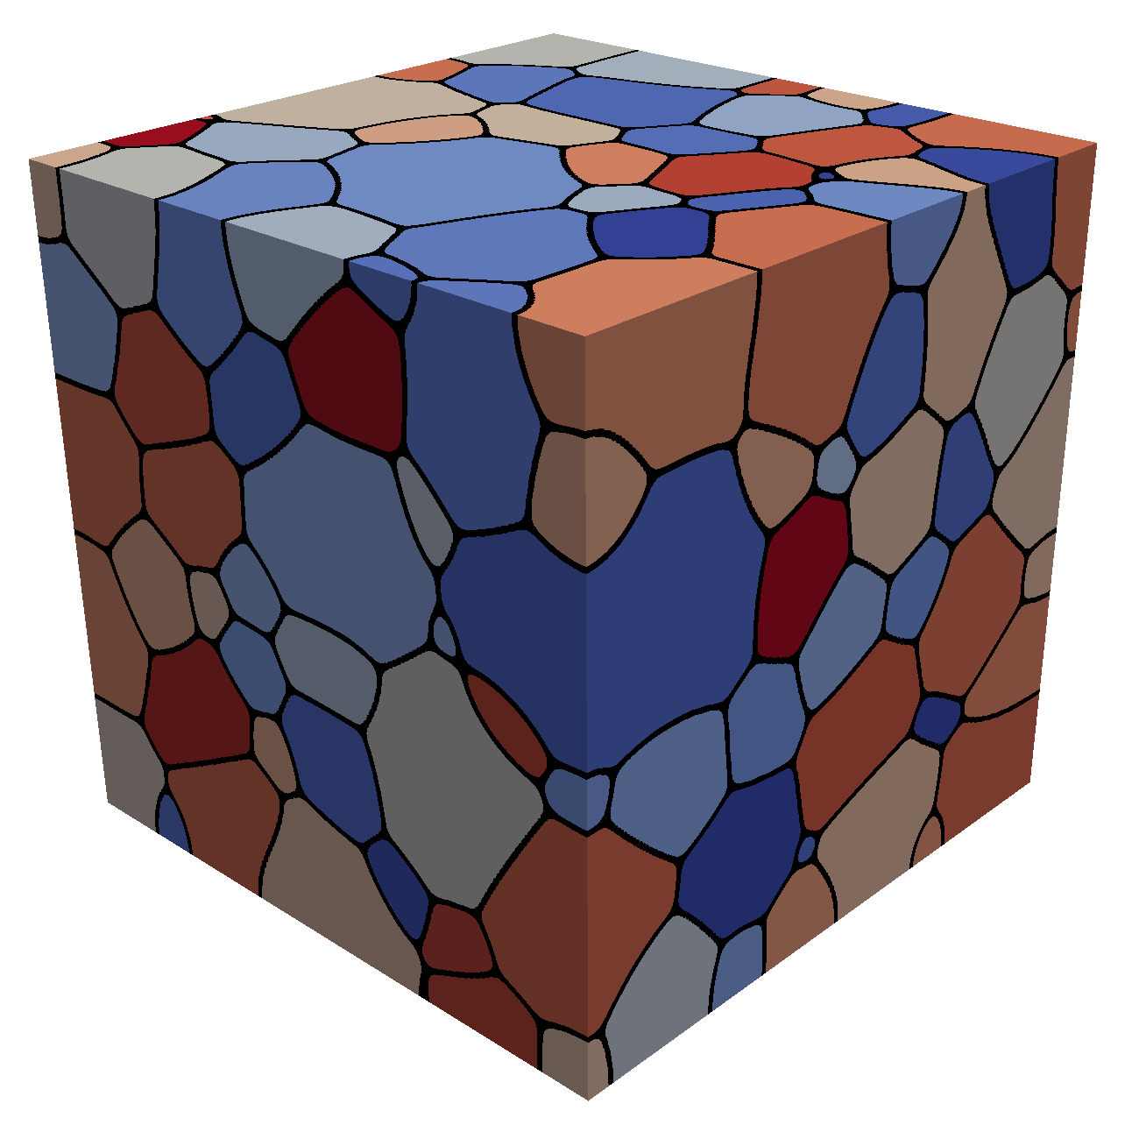
Grain growth
Due to grain boundary migration, the average grain size goes up with time during annealing/heat treating
As grain boundaries migrate, some grains grow and some shrink
Shrinking grains eventually disappear
The average grain volume
Therefore, as N_{grains} decreases due to grain disappearance, the average grain volume goes up

Slide 13
Grain boundary mobility
The grain boundary mobility is a function of temperature and GrB type
The grain boundary mobility is determined according to
m⁴/(J s)
k_{b} = 8.6173e-5 eV/K is the Boltzmann constant
Both the pre-factor M₀ and the activation energy Q change as a function of the grain boundary misorientation
We often use an average grain boundary for a material, taken from polycrystal measurements-> UO2: M₀ (m⁴ /J-s) = 4.6e-09, Q (eV) = 2.77
What is the mobility of UO₂ at 1600 K?
M_{GB} = 4.6e-9*exp(-2.77/(1600*8.6173303e-5)= 8.7e-18 m⁴/J-s

Slide 14
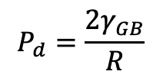
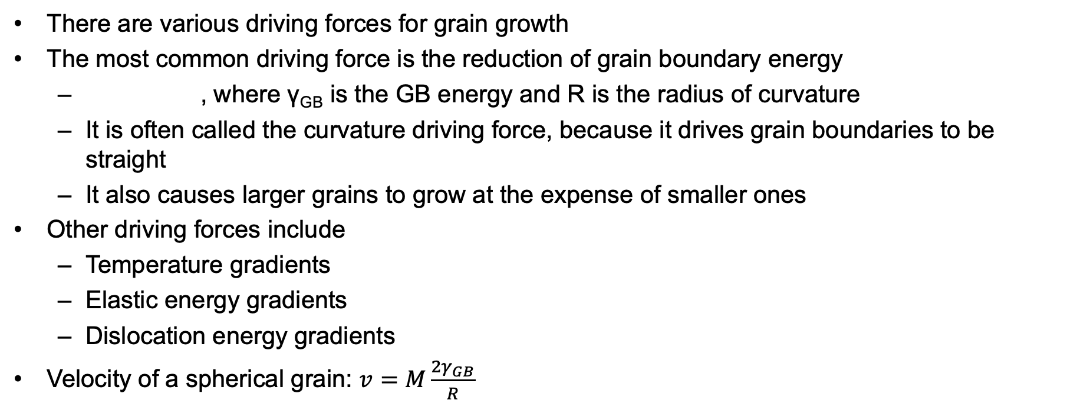
Grain growth
There are various driving forces for grain growth
The most common driving force is the reduction of grain boundary energy
, where γ_{GB} is the GB energy and R is the radius of curvature
It is often called the curvature driving force, because it drives grain boundaries to be straight
It also causes larger grains to grow at the expense of smaller ones
Other driving forces include
Temperature gradients
Elastic energy gradients
Dislocation energy gradients
Velocity of a spherical grain: $v=M\frac{{2γ}_{GB}}{R}$
$$P_{d}=\frac{{2γ}_{GB}}{R}$$

Slide 15

Grain growth
Grain boundary motion is inhibited by pores, precipitates, solute atoms, etc.
Solute atoms (whether in interstitial sites or vacancies) can decrease the grain boundary mobility.
This is called Solute Drag
Even a small concentration of impurities can decrease the mobility by 3 to 4 orders of magnitude
Particles and pores resist grain boundary motion

Slide 16
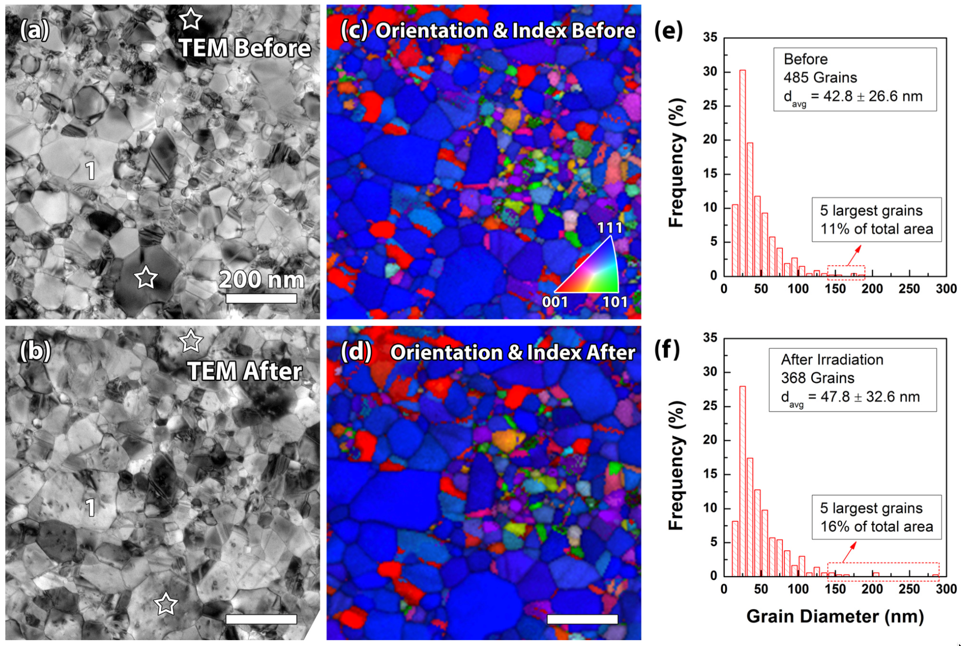
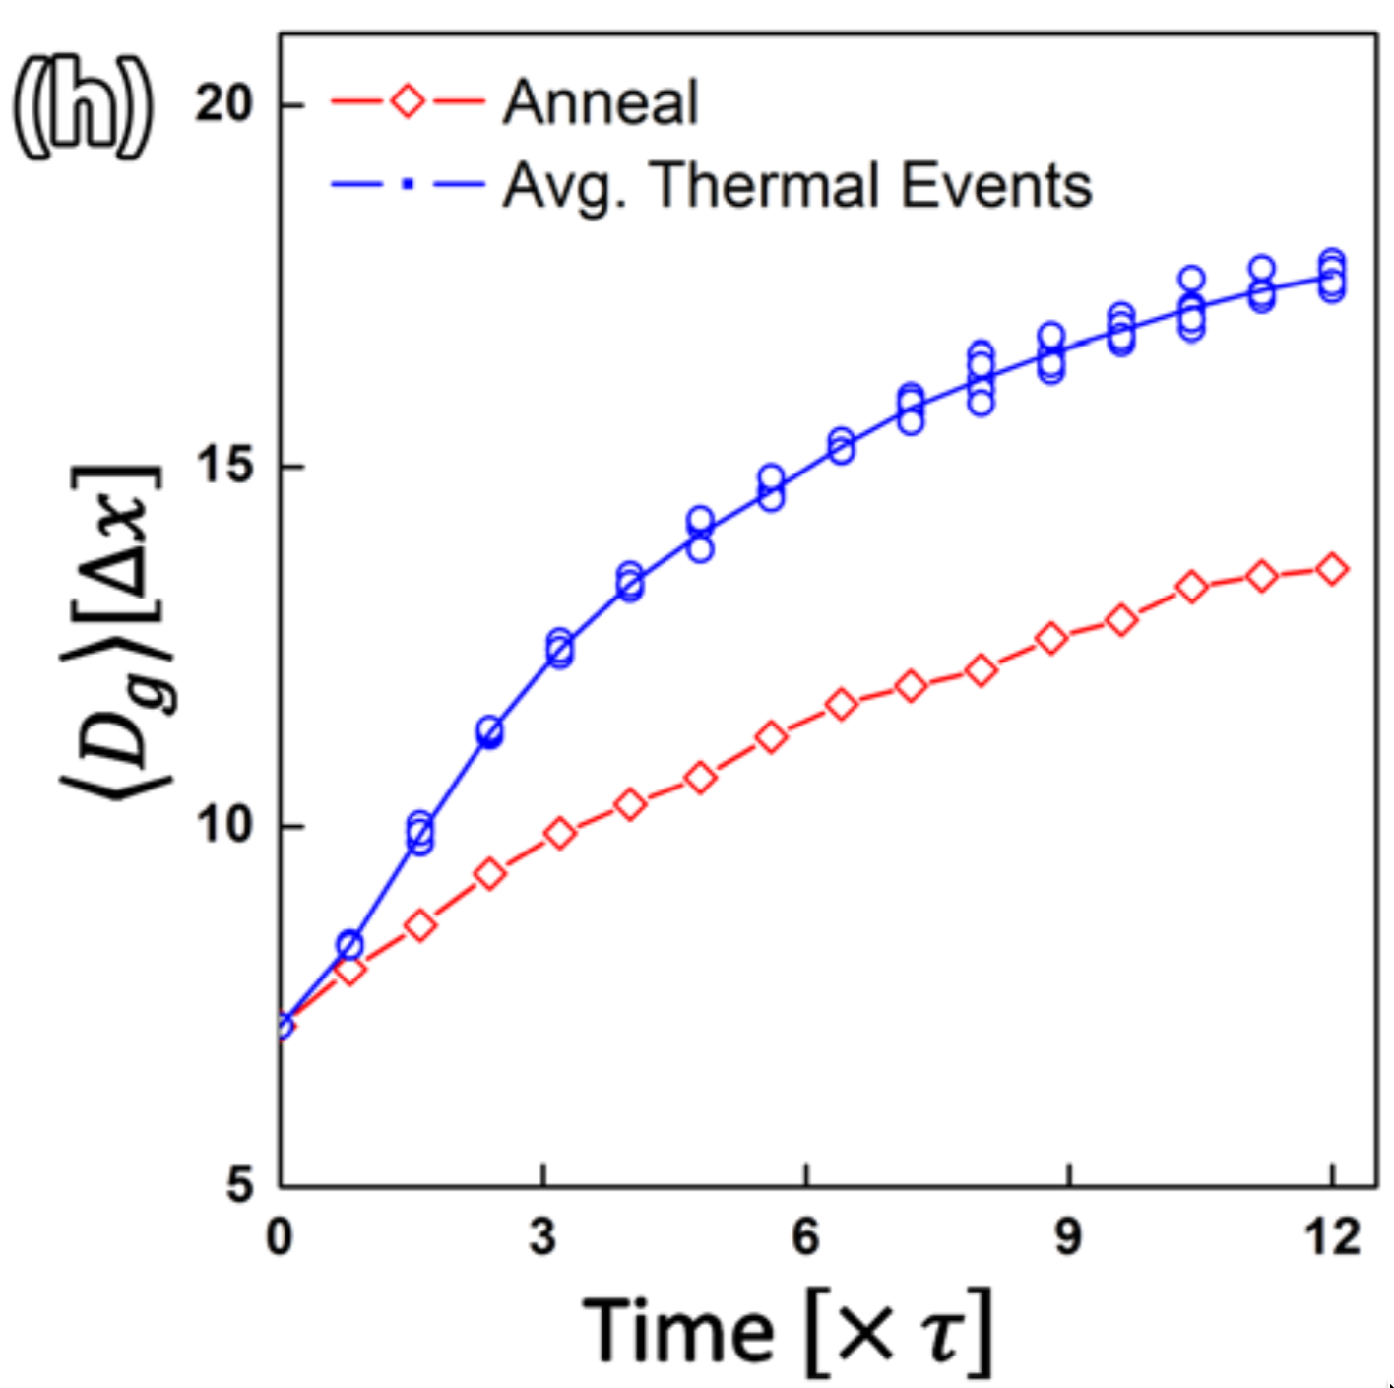
Irradiation can accelerate grain growth, but it is only significant with small grains and low temperature

Slide 17
Maximum grain size
Consider a material with an average grain size D
The change in D can be written as
k = 2 M_{GB} γ_{GB} is a rate constant that can be determined from experiments
D_{m} is the grain size at which the driving force equals the resistive pressure
For UO2:
D_{m} is a function of temperature microns

Slide 18
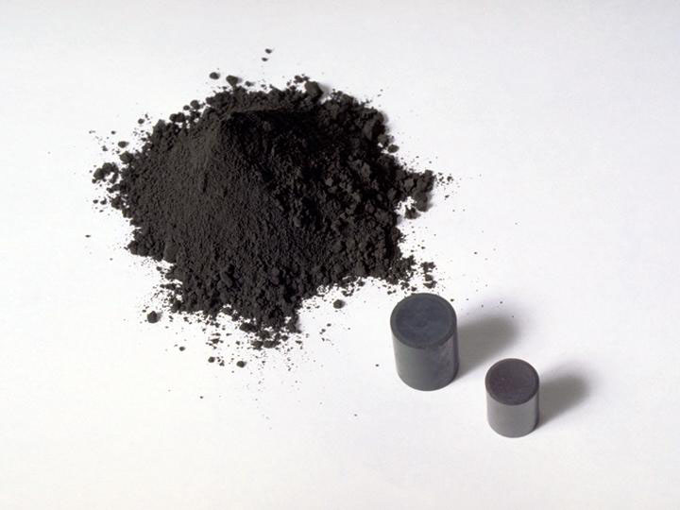
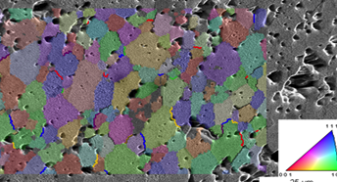
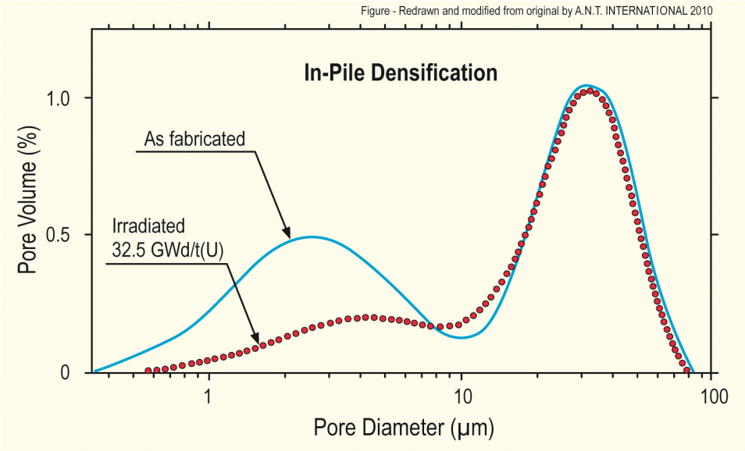
Fuel Densification
Remember that fresh fuel pellets are not fabricated to be 100% dense, more like 95-99% dense
Early in life, fuel pellets shrink and the initial porosity is largely eliminated
In some ways, densification is a continuation of the sintering process
However, irradiation accelerates the process
Small pores close due to effects of fission spikes and vacancy diffusion
Large pores stable (in absence of large hydrostatic stress)
Pellets with higher initial density, densify less

Slide 19
Densification
The driving force for densification is the change in free energy from the decrease in surface area of pores and lowering of the surface free energy
An empirical relation to describe densification has been built as a function of
β - Burnup (in FIMA)
Δρ₀ – Total densification that can occur ~ 0.01
β_{D} – Burnup at which densification stops ~5 MWD/kgU, ~0.005 FIMA
C_{D} = 7.235 − 0.0086 (T − 25) for T < 750C and CD = 1 for T ≥ 750C

Slide 20
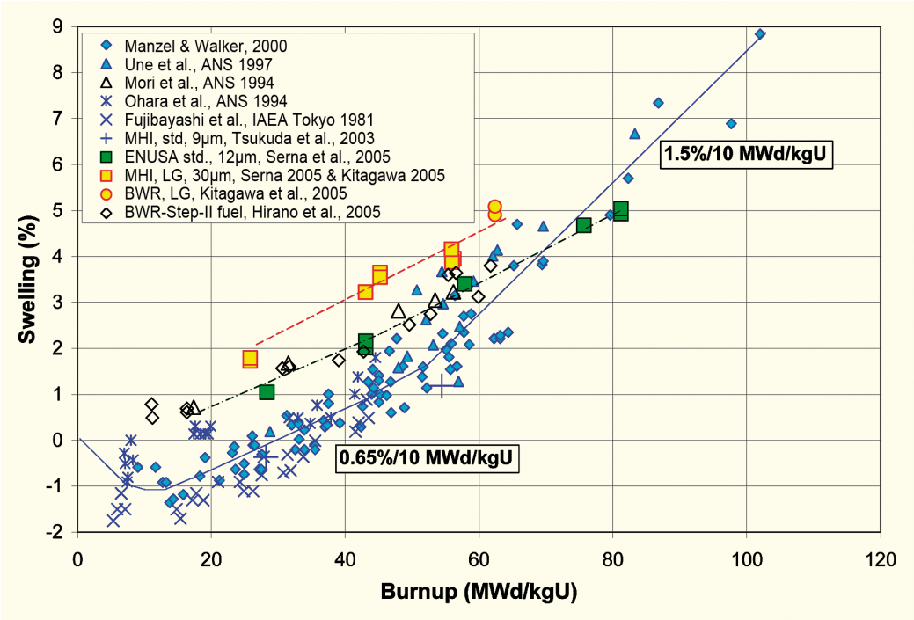
Empirical models
Many models of reactor fuel behavior are fits to experimental data
They are typically correlated to burnup
Burnup is a measure of how much fissioning has taken place. Typical units are:
MWD/kgU
FIMA
It can be calculated from the volumetric fission rate
Units of this equation are FIMA
To convert from FIMA to MWD/kgU, multiply by ~950
after Garzarolli in [Rudling et al, 2007]

Slide 21
Summary
The average grain size in UO₂ impacts fuel behavior and performance:
Fission gas release
Swelling
Thermal conductivity
Creep
The material wants to reduce its energy by having large grains grow at the expense of small grains
Grain growth is reduced due to other defects reducing the grain boundary migration
Fuel densification is driven by reduction in surface area of pores – continuation of sintering process
Empirical models describe densification as a function of burnup

Slide 22
Fuel chemistry

Slide 23
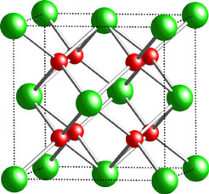
Fuel Chemistry
UO₂ is an ionic compound that must have balanced charges
What is the charge of a typical oxygen ion?
O²⁻
Uranium valance states
Possible: U³⁺, U⁴⁺, U⁵⁺, U⁶⁺
Most stable: U⁴⁺, U⁵⁺, U⁶⁺
Beyond UO2, can have U4O9, U3O8, UO3
The structure is very stable all the way up to the melting temperature and down to extremely low temperatures, even with irradiation damage
There is space in the uranium lattice that can accommodate fission products

Slide 24
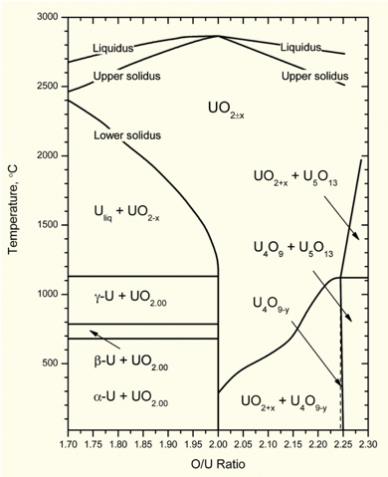
O/M ratio
The ratio of oxygen to uranium metal (O/M ratio) can vary
This is the stoichiometry
The homogeneity range of uranium dioxide extends to both hypo- and hyperstoichiometric compositions in oxygen
The minimum and maximum oxygen contents in the dioxide correspond to the compounds with the formula of respectively UO_{1.67} at 2720 K and UO_{2.25} at approximately 2030 K
Will the O/M ratio go up or down during reactor operation?
It is complicated, because of the formation of fission products that also react with the oxygen, and O interaction with Zr cladding

Slide 25
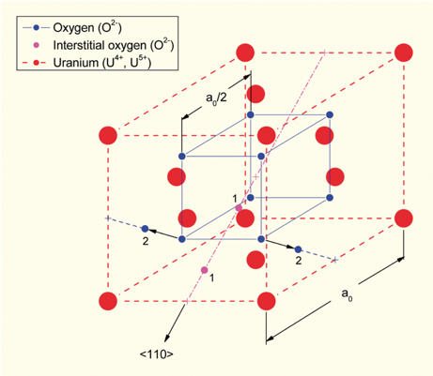
Excess O
The crystal structure of UO₂ can accommodate extra oxygen
Excess oxygen resides at interstitial locations
Oxygen in neighboring sites is displaced
Cation valence increases to maintain electrical neutrality
Fuel fabricated to be nearly stoichiometric; i.e., UO2.00± because:
It is the most stable
It has the highest melting temperature
[after Olander, 1976]

Slide 26
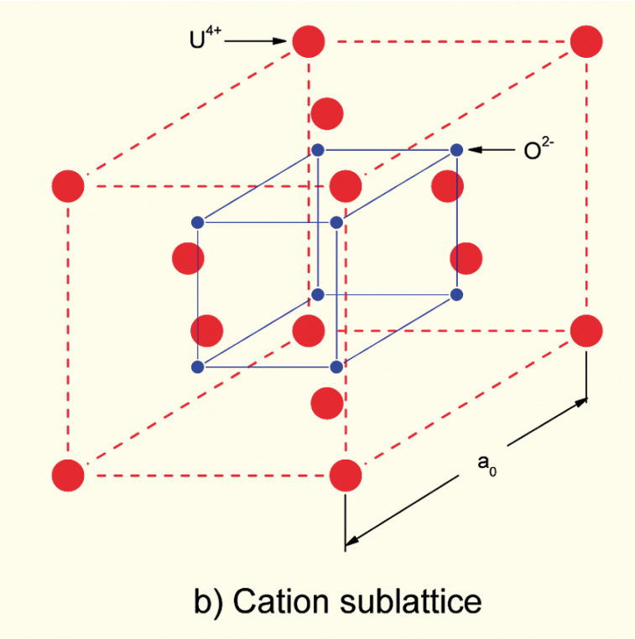
Incorporation of Fission Products
As fission products form, the valence state of the uranium can change
Typical valence of soluble fission products is M³⁺
The uranium valence state changes to compensate
Oxygen liberated by fission
Fission products produced with M³⁺ valance state incorporated in fuel lattice
Uranium oxidizes from U⁴⁺ to U⁵⁺ or U⁶⁺ to maintain local electrical neutrality

Slide 27
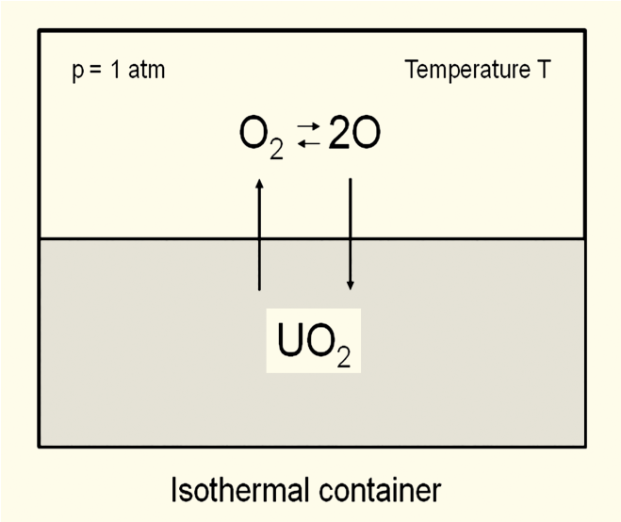
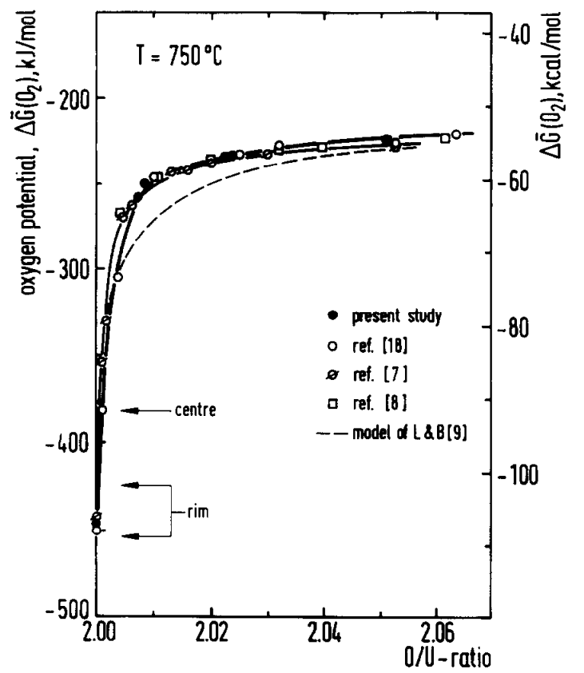
Oxygen potential
The oxygen potential is a measure of how free the oxygen is to escape/move around
Oxygen potential is defined as:
or, equivalently:
With = Chemical potential of oxygen in solution
= Gibbs free energy of gaseous oxygen at temperature T and a standard pressure (1 atm)
It is possible to determine the stoichiometry from the oxygen potential

Slide 28
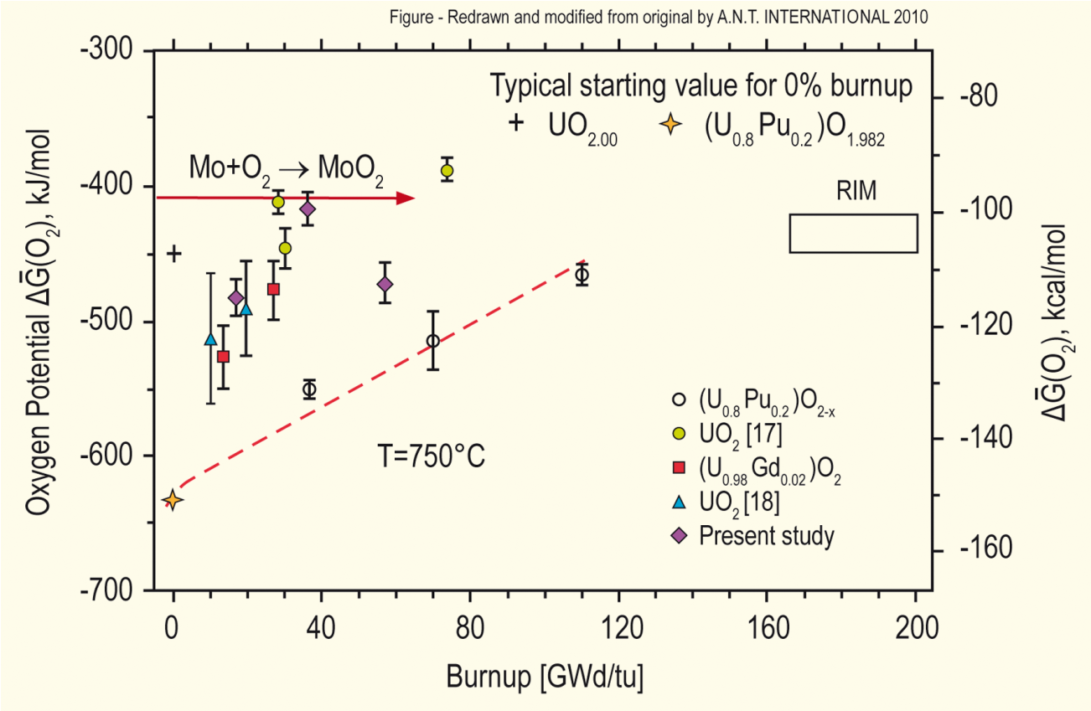
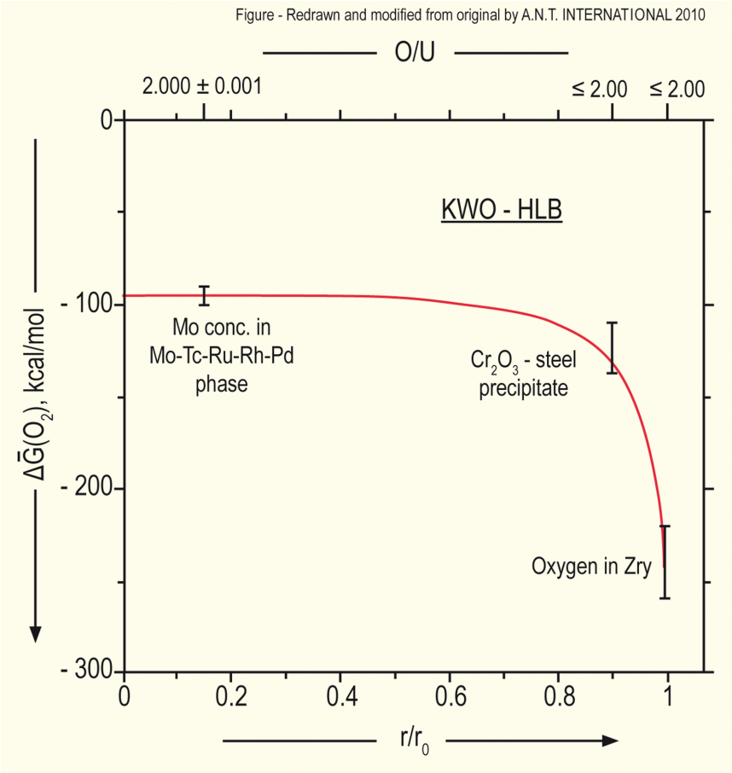
Oxygen potential
The oxygen potential changes during irradiation, indicating change in the O/M ratio
Oxygen potential changes during irradiation due to
Liberation of oxygen by fission; Generation of fission products; Conversion of uranium to plutonium; Reaction of oxygen with U, Pu, fission products, and cladding
Oxygen potential across pellet radius observed to be constant at the approximate value of Mo/MoO₂ reaction (from calculations)
Mo serves as a buffer to the O potential, or a means of inferring what the oxygen potential may have been in the fuel from PIE
Oxygen potential is low near the cladding, because the oxygen enters the cladding

Slide 29
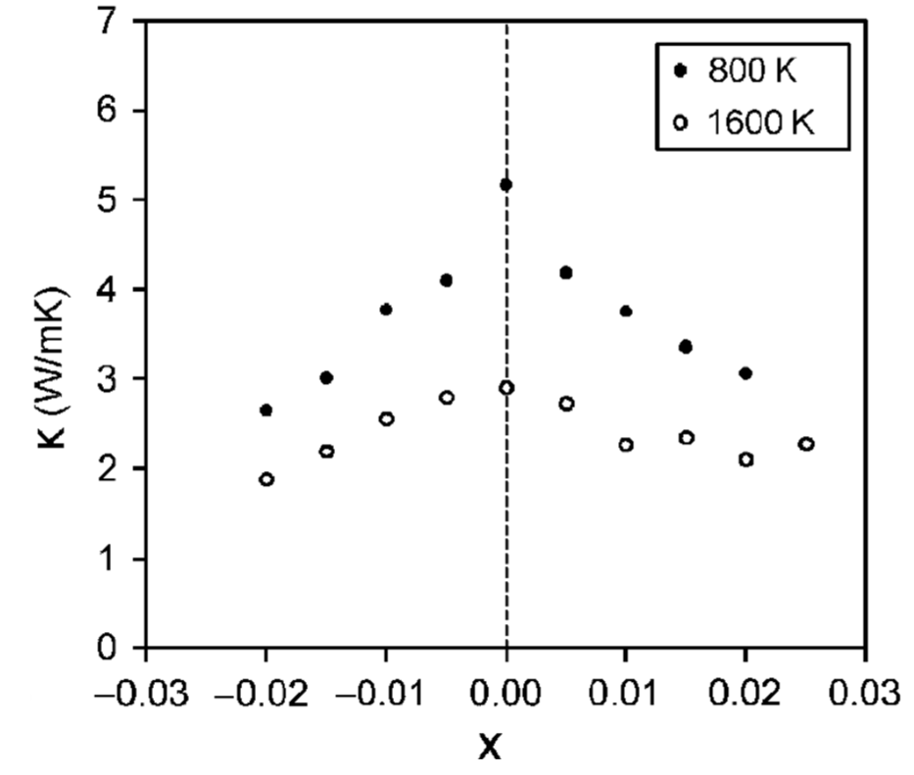
Fuel Stoichiometry/Properties
The stoichiometry of the fuel directly impacts the fuel performance
Stoichiometry impacts
Melting temperature
Thermal conductivity
Processes dependent on diffusion
Grain growth
Fission gas release
Creep
Chemical state and behavior of fission products
Chemical reactions at inner cladding surface
Thermal conductivity is highest for stoichiometric UO2

Slide 30
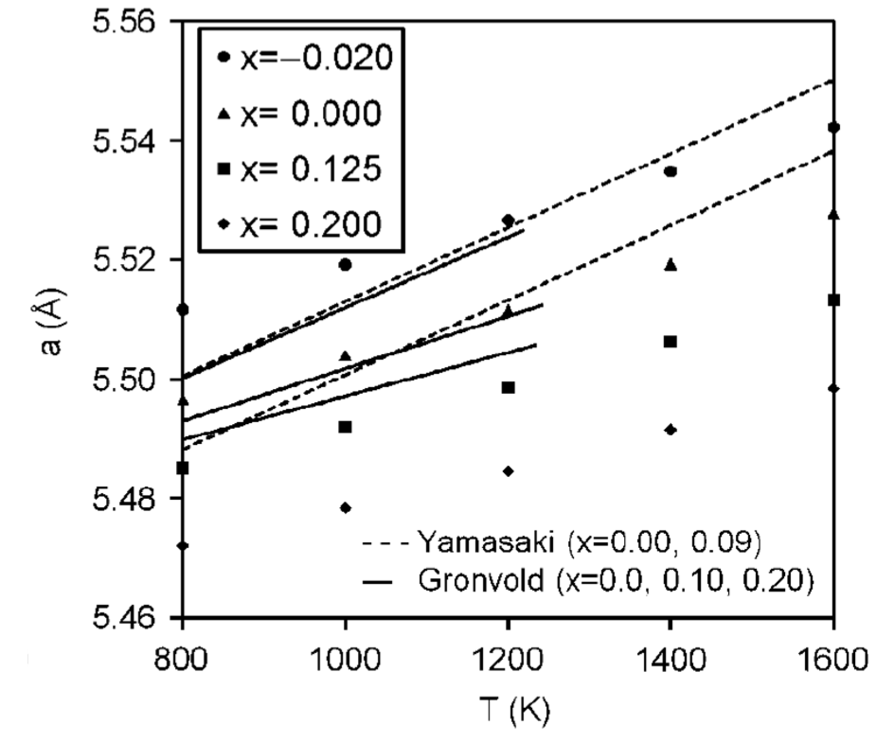
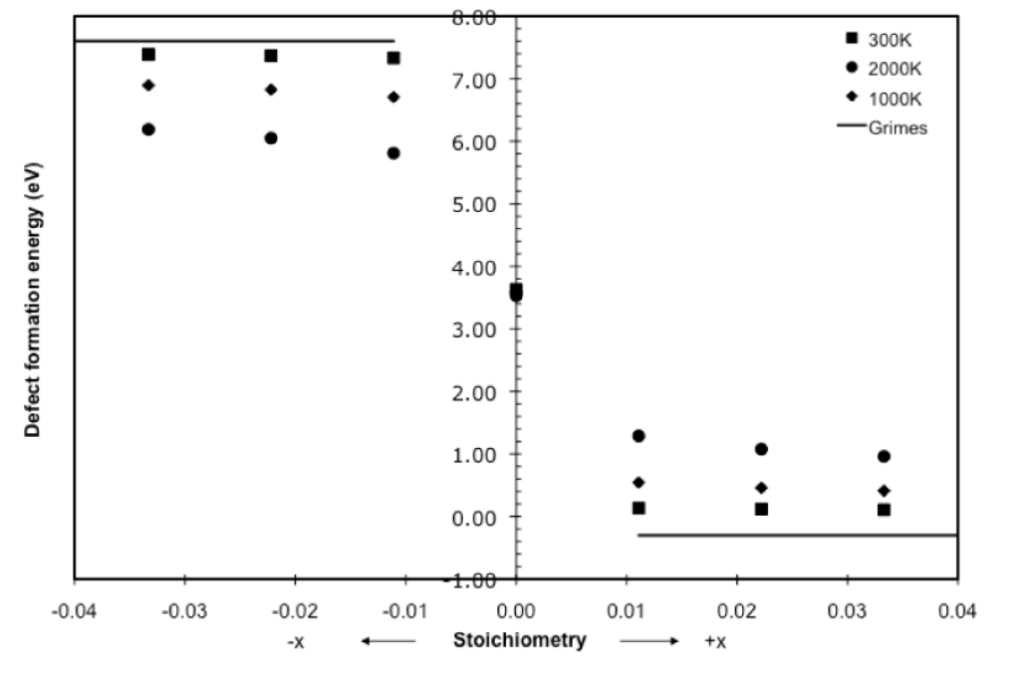
Fuel Stoichiometry/Properties
The lattice constant of the material decreases with increasing stoichiometry
The vacancy formation energy also changes with stoichiometry

Slide 31
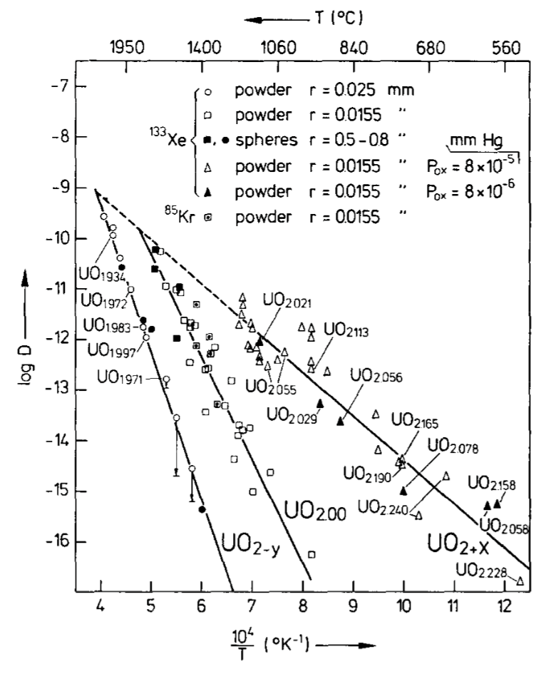
Fuel Stoichiometry/Properties
Fission product | UO_{1.97} | UO₂ | UO_{2.03}
Xe | 3.88 eV | 3.88 ev | 2.61 eV
Cs | 1.7 eV | -0.04 eV | -3.29 eV
Sr | -3.71 eV | -6.03 eV | -9.55 eV
The solution energy of Xe, Cs, and Sr in UO₂ depends on stoichiometry as well
The coefficient defining Xe diffusion also changes with stoichiometry
Though stoichiometry matters, most fuel performance codes ignore it

Slide 32
Fission products

Slide 33
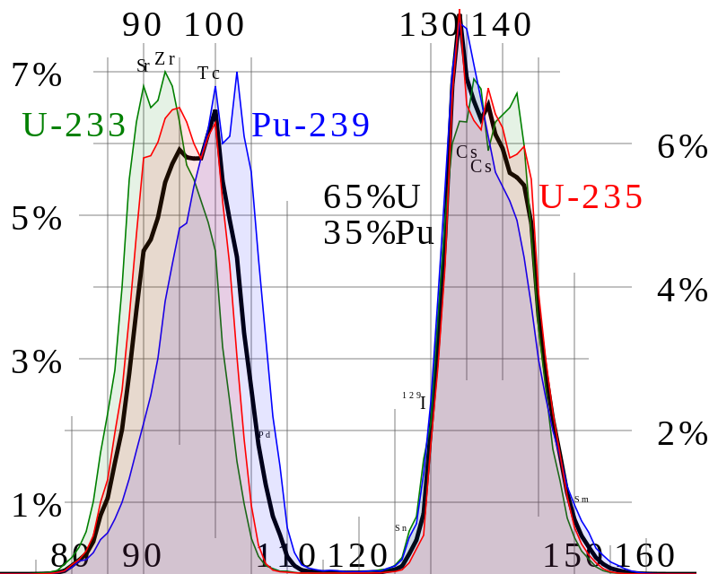
Fission Product Generation
Fission releases around 200 MeV
The fission fragments have 169 MeV of kinetic energy
2 to 3 neutrons with an average energy of 2 MeV
7 MeV of prompt gamma ray photons
The remaining energy is released by beta decay
Every fission product that is produced is now in the crystal lattice of the fuel, changing the chemistry/microstructure

Slide 34
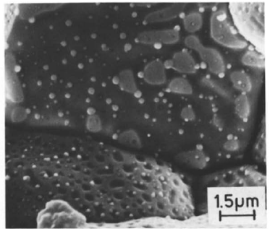
There are various types of fission products that form in the fuel
Soluble oxides (Y, La and the rare earths)
Dissolved in the cation sublattice
Insoluble oxides (Zr, Ba and Sr)
Form insoluble oxides in the fluorite lattice
Metals (Mo, Ru, Pd, and Tc)
Form metallic precipitates
Volatiles (Br, Rb, Te, I and Cs)
Exist as gases at high temperatures of the pellet interior
Also exist as solids at the cooler pellet exterior
Noble gases (Xe, Kr)
Essentially insoluble in the fuel matrix
Form either intragranular (within grain) voids or bubbles or intergranular (grain boundary) bubbles

Slide 35
All of the fission products impact the behavior of the fuel

Slide 36
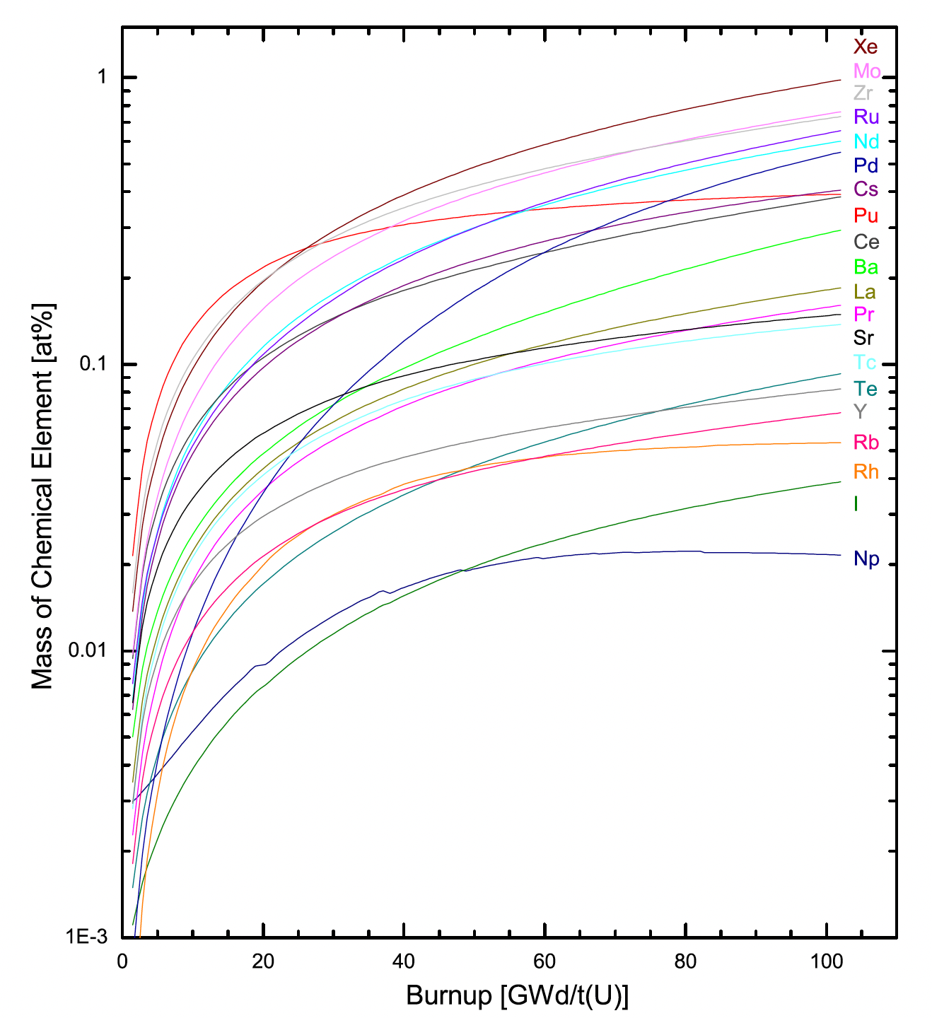
Fission Product Evolution
There are continuous transitions between the groups as the critical concentration conditions for new phase development are surpassed because of increased burnup
Not only are the absolute proportion of fission products accumulating with time, but the relative proportions are changing with respect to one another
Since fission releases two oxygen but only one metal atom, and not all metal atoms will react to bond the oxygen, the O/M ratio of the fuel slowly increases during burnup

Slide 37
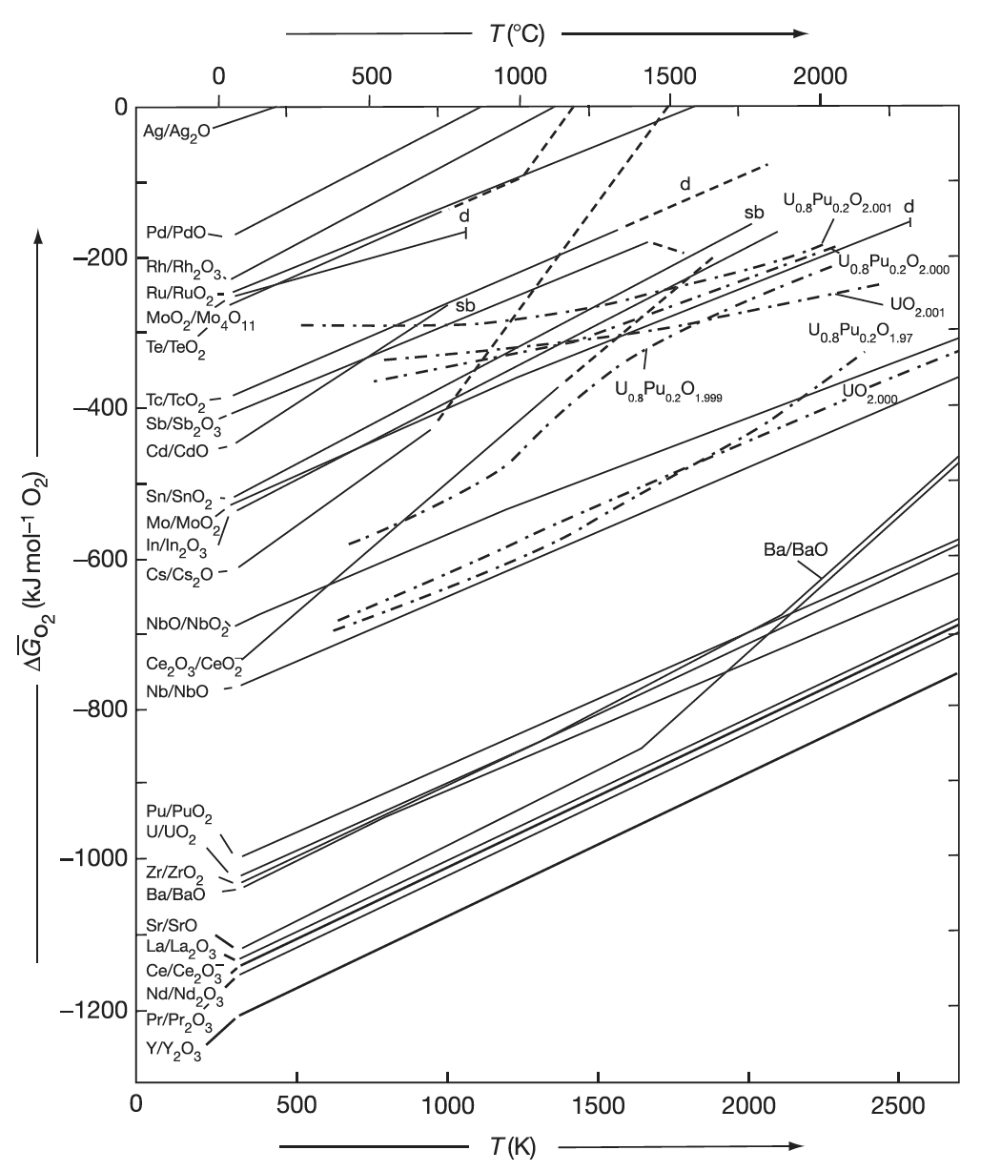
Oxide Formation
With burnup, the liberated oxygen will associate with U, Pu, and La but may not be in sufficient supply to combine with Pd and other less oxidizing elements
If the Gibbs energy of formation of the given fission product lies below the fuel oxygen potential, the element will be capable of forming an oxide (Ce, Sr, Ba)
If the fission product point is above the chemical potential in the fuel, the fission product will exist as an element in the fuel (in a separate metallic phase) (Ru, Pd, Tc)

Slide 38
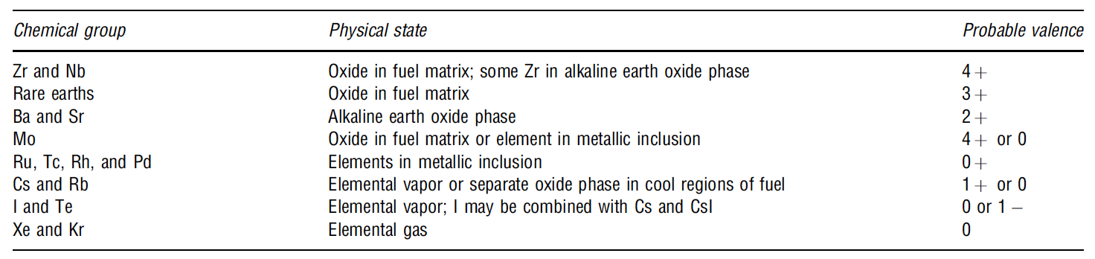
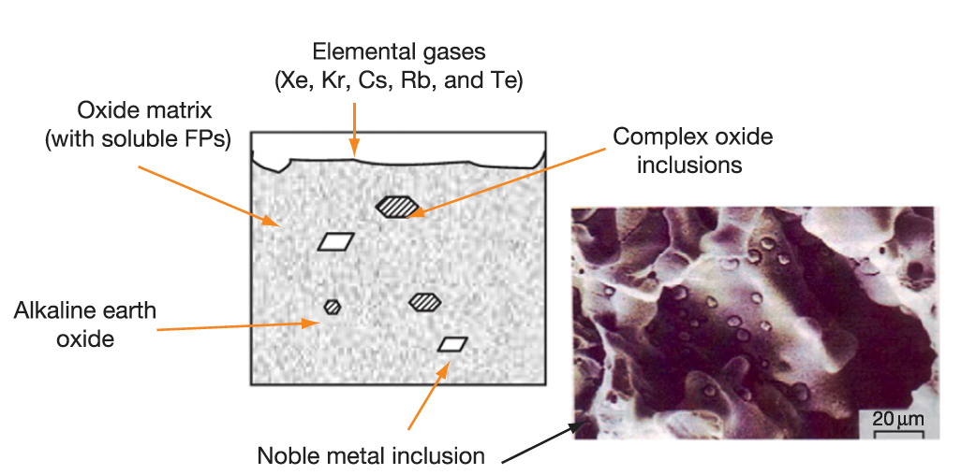
Soluble/Insoluble Fission Products
When a 4+ valence fission product (e.g.,Zr4+) enters the lattice, there is no change in the electrical neutrality
If the charge of the fission-product cation is lower than U+4, the site occupancy of the lattice is altered to achieve electrical neutrality
The alkaline earth cations Ba+ and Sr2+ have large ionic radii and form a separate oxide phase
Fission products that have limited solubility in UO2 will segregate to the grain boundaries and voids

Slide 39
Fission Product Segregation
Fission products can be segregated because of their migration to specific locations such as intragranular segregations, grain boundaries, or pellet surfaces
Metallic inclusions are commonly observed in ceramographs from irradiated samples
They are formed by isotopes of Mo, Tc, Ru, Rh, Pd, Ag, Cd, In, Sn, Sb, and Te
These inclusions are found at the surface of the grain boundaries and are associated, in general, with grain boundaries and intragranular bubbles
Some of the components of these precipitates can be oxidized or reduced forming other compounds that can be released from the fuel matrix
Cs, Ru, Te, and Ba have been consistently found at the cracks in the pellet and on the clad inner surface
The white inclusions are metallic precipitates, which are composed of Mo, Tc, Rh, Ru, and Pd, form a quinary alloy in an hcp structure
A “gray oxide phase” perovskite structure containing different combinations of Ba, Cs, Zr, Mo, and U can also form

Slide 40
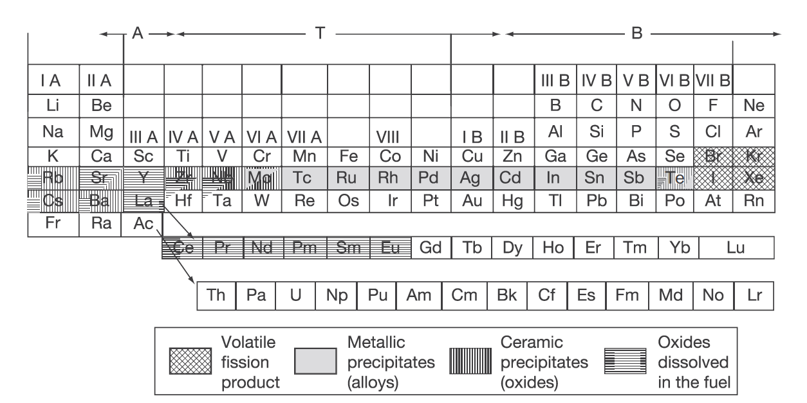
Volatile Fission Products
Xe release occurs at the central region of the pellet where the highest temperatures were achieved during irradiation
Volatile FPs are released from the fuel matrix similar to that of the noble gases
Volatile fission products in the gap can react among themselves, resulting in a changing chemical speciation
The kinetics of formation/decomposition of CsI and Zr iodides are possible factors in the mechanism of SCC

Slide 41
FP Interaction with Zr Cladding
Fission fragments will deposit on the inner surface of the cladding
Some of these species can diffuse into the cladding, while others can attack the cladding thereby initiating cracks that can later progress with the formation of through-wall cracks
Oxygen will diffuse into the cladding and contribute to its oxidation state
Measurements have shown deposits of Sr, Cs, Pu, and Am
The corrosion behavior of zirconium by Te has been reported
The chemical reaction between some corrosive fission products and the cladding can lead to PCI
Fission products such as Cs, Cd, or I can attack the cladding inducing crack initiation, which then progress through the cladding by intragranular and transgranular cracking modes

